Slide 1
Online shoppers Intentions
ML PROJECT
- Venu Gopal Rao Pendyala
Batch Code: l87st2

Slide 2
Problem Statement - Objective
This is the data of an online retailing company where they are trying to find which online shopper will generate revenue by his/her online shoppers’ activity on their site.
People often spend lot of time browsing through online shopping websites, but the conversion rate into purchases is low. Determine likelihood of purchase based on the given features in the dataset. The dataset consists of 18 features belonging to 12,330 online transactions.
The Objective of this project is to identify the user behaviour patterns to effectively understand features that influence n create a ML model which predicts shopping intent of website visitors to PURCHASE or NO PURCHASE.

Slide 3
Feature
Analysis
Features | Description | DataType
Administrative | Number of the pages visites by the user for user account management related activities | Discrete values from 0 to 27
Administrative_Duration | Time spent on admn page by user | continuous value of time in seconds
Informational | Number of pages visites by user for information | Discrete values from 0 to 24
Informational_Duration | Time spent on informational page by user | continuous value of time in seconds
ProductRelated | Number of product related visited by the user | Discrete values from 0 to 705
ProductRelated_Duration | Time spent on productrelated pages by user | continuous value of time in seconds
BounceRates in % | Average bounce rate of the pages visited by the user | continuous value
ExitRates in % | Average exit rates of the pages visited by the user | continuous value
PageValues | Average page value of the pages visited by the user | continuous value
SpecialDay (probability) | special event days like mothers day, valentine day etc., | Discrete values 0.2, 0.4, 0.6, 0.8, 1.0
Month | Month of the visit from Jan to Dec of the year | Categorical
OperatingSystems | Operating systems used by visited users in their systems | Discrete values from 1 to 8
Browser | Browser used by the user to visit the web site/shoppers site | Discrete values from 1 to 13
Region | Region of the user from where they started the session | Discrete values from 1 to 9
TrafficType | Traffic source from where user entered the website | Discrete values from 1 to 20
VisitorType | Visitor type as new visitor or returning visitor | Categorical
Weekend | If the user visited on weekend or not | Boolean
Revenue | If the user revenue generated or not | Boolean
Output Variable : Revenue
Datatypes : Int-7, Float – 7, Obj – 2, Bool – 2
No Null Values
No Duplicates
Outliers Treatment to be done

Slide 4
Data Description - Stats
Feature | count | mean | std | min | 25% | 50% | 75% | max
Administrative | 12330.0 | 2.315166 | 3.321784 | 0.0 | 0.000000 | 1.000000 | 4.000000 | 27.000000
Administrative_Duration | 12330.0 | 80.818611 | 176.779107 | 0.0 | 0.000000 | 7.500000 | 93.256250 | 3398.750000
Informational | 12330.0 | 0.503569 | 1.270156 | 0.0 | 0.000000 | 0.000000 | 0.000000 | 24.000000
Informational_Duration | 12330.0 | 34.472398 | 140.749294 | 0.0 | 0.000000 | 0.000000 | 0.000000 | 2549.375000
ProductRelated | 12330.0 | 31.731468 | 44.475503 | 0.0 | 7.000000 | 18.000000 | 38.000000 | 705.000000
ProductRelated_Duration | 12330.0 | 1194.746220 | 1913.669288 | 0.0 | 184.137500 | 598.936905 | 1464.157214 | 63973.522230
BounceRates in % | 12330.0 | 0.022191 | 0.048488 | 0.0 | 0.000000 | 0.003112 | 0.016813 | 0.200000
ExitRates in % | 12330.0 | 0.043073 | 0.048597 | 0.0 | 0.014286 | 0.025156 | 0.050000 | 0.200000
PageValues | 12330.0 | 5.889258 | 18.568437 | 0.0 | 0.000000 | 0.000000 | 0.000000 | 361.763742
SpecialDay (probability) | 12330.0 | 0.061427 | 0.198917 | 0.0 | 0.000000 | 0.000000 | 0.000000 | 1.000000
OperatingSystems | 12330.0 | 2.124006 | 0.911325 | 1.0 | 2.000000 | 2.000000 | 3.000000 | 8.000000
Browser | 12330.0 | 2.357097 | 1.717277 | 1.0 | 2.000000 | 2.000000 | 2.000000 | 13.000000
Region | 12330.0 | 3.147364 | 2.401591 | 1.0 | 1.000000 | 3.000000 | 4.000000 | 9.000000
TrafficType | 12330.0 | 4.069586 | 4.025169 | 1.0 | 2.000000 | 2.000000 | 4.000000 | 20.000000

Slide 5
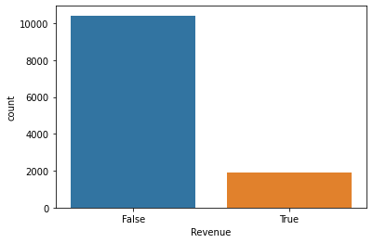
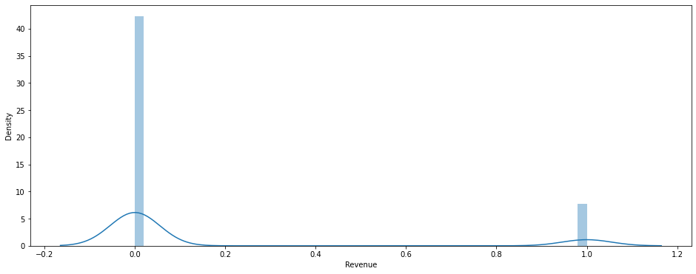
EDA – TARGET ANALYSIS
Out of total 12330 transactions only 1908 transactions converted to Purchase transactions, which is only 15%.
Major chunk of Purchase transactions occurred from the transaction visited Admn and Information pages. Which is around 22%.
50% i.e., transactions directly visited Product page may be visited from out side referal websites but revenue generated transactions are very low at 8% only.

Slide 6
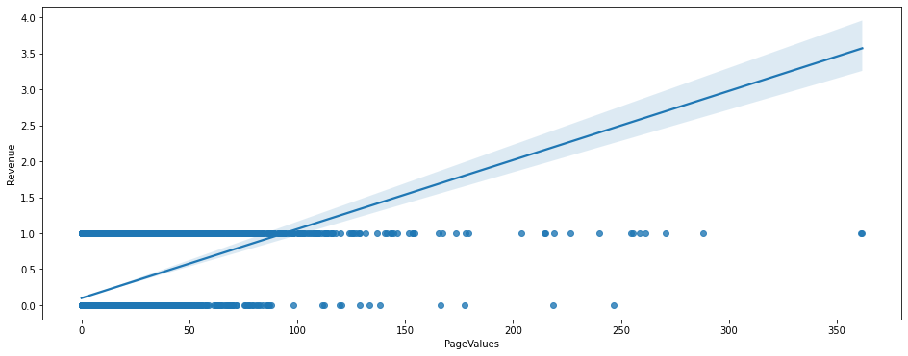
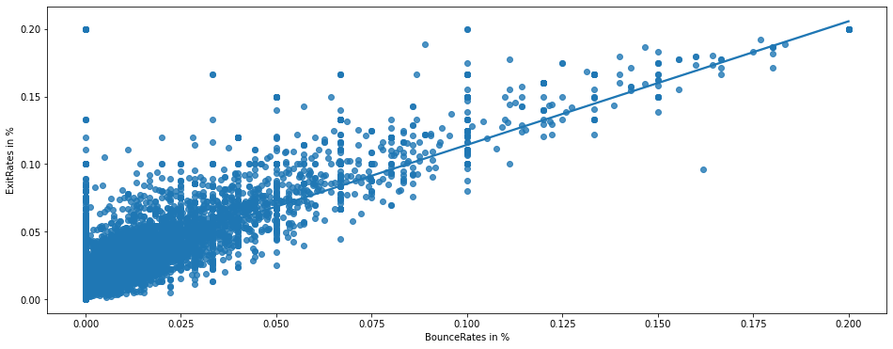
EDA – COLLINEARITY
Observations :
Based on correlation and heat map observations it is found that only Page values have linear relation with Revenue
There is also multicollinearity observed between Bouncerates and Exitrates

Slide 7
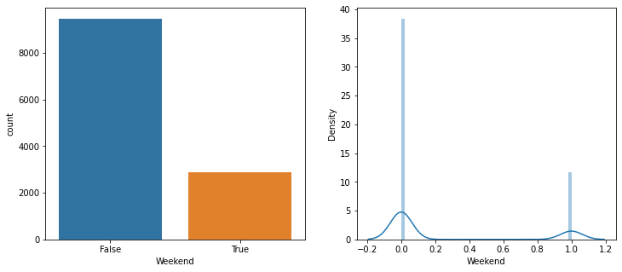
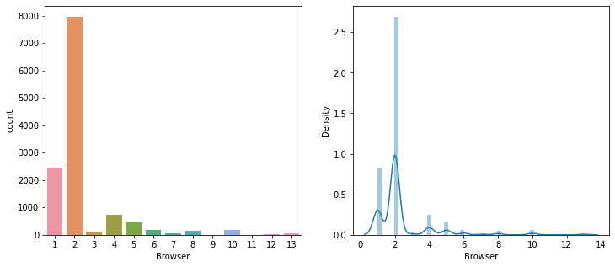
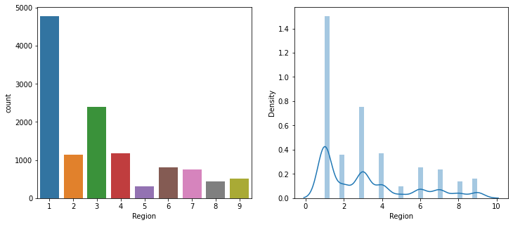
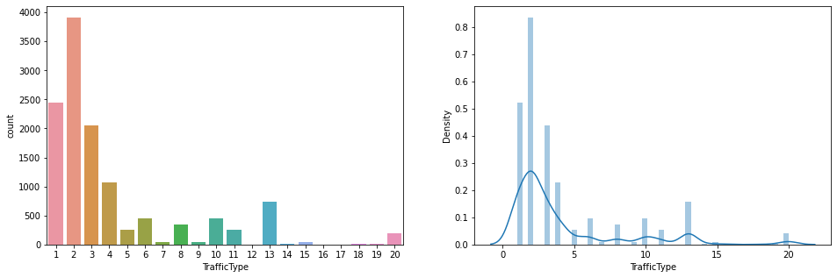
EDA – UNIVARIATE ANALYSIS
Only 23%(around 2900) page visits happened in weekends, rest of 77% visits happened in other days.
Highest page visits and Purchase page visits observed from Browser 2 Followed by page visits of Browsers 1, 4,5.
It is observed that Region 1 leading with 39% page visits followed by 3 with 20%
It is observed that Traffic type 2 leading with 31% page visits followed by 1 with 20% Next level observed with Traffic type 3 and 4 with 16% and 8% page visits.

Slide 8
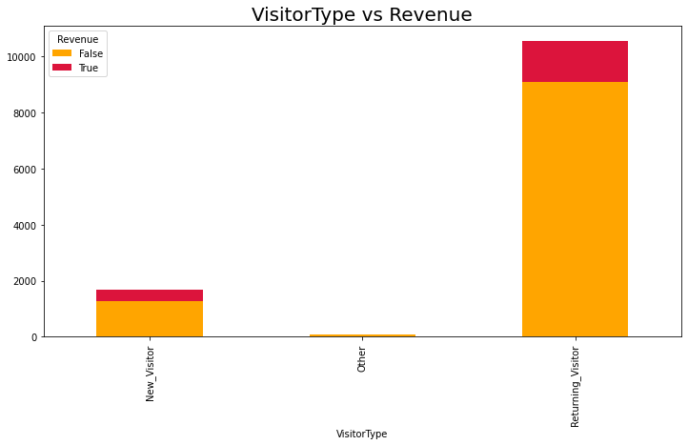
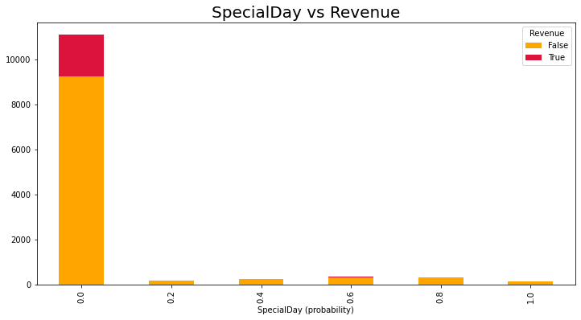
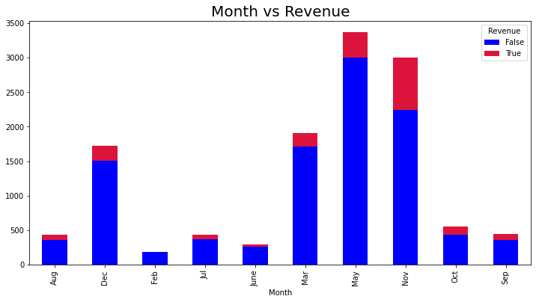
EDA – BI VARIATE ANALYSIS – TARGET VS FEATURE
Highest Purchase page visits happened in Nov month and then in May month.
Highest page visits and Purchase page visits observed from Returning Visitor, Followed by page visits of New visitors.
Special day impact on page visits or Revenue generated page visits is not visible hence there is no impact

Slide 9
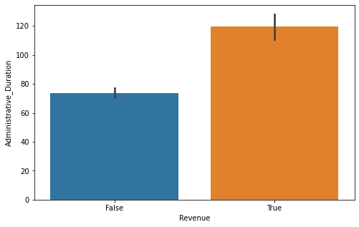
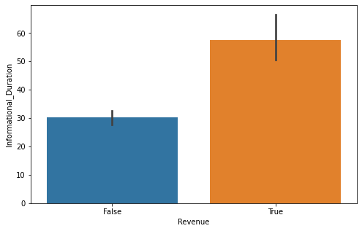
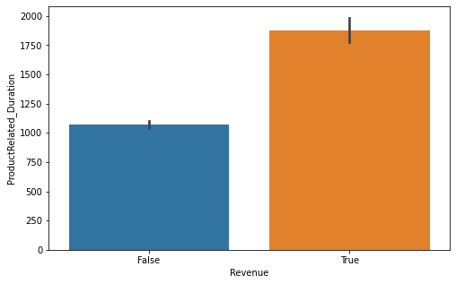
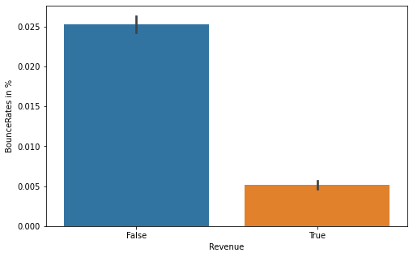
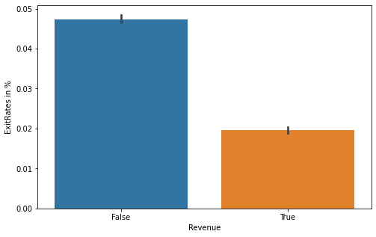
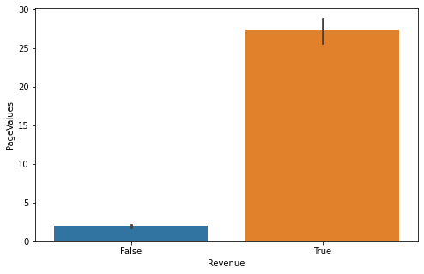
EDA – BI VARIATE ANALYSIS – TARGET VS FEATURE
Administrative Duration, Informational duration, product related duration and Page values has positive impact on Revenue.
Where as Bounce Rates, Exit Rates have negative impact on Revenue generated page visits.

Slide 10
DATA PREPROCESSING
No null values and no duplicates.
ONE HOT ENCODING done on two categorical variables i.e., Month and Visitor type.
Label Encoding done on Bool variables i.e., Weekend and Revenue.
Scaling done on numerical variables using Standard scaler.
Outliers treatment done thru capping and flooring by taking <1% for flooring and >99% for capping.
Data set found to be imbalanced as major > 2 times minor. To handle this Random oversampling done after applying K fold cross validation.

Slide 11
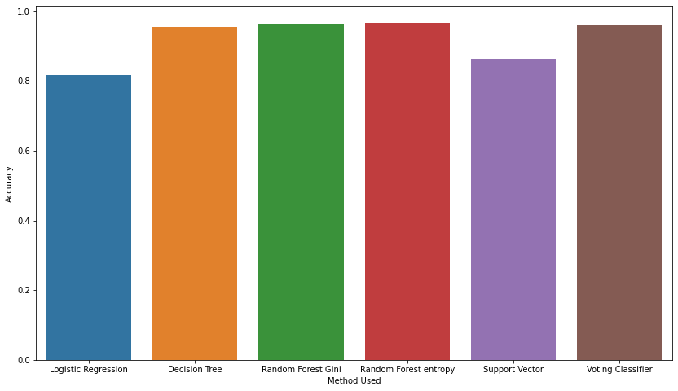
MODEL FITTING & PERFORMANCE
Total 5 models used in the process to observe which model is delivering better results, then all models given input to voting classifier to combine the output of all models to get refined output.
But observed Random Forest model has done farely good job and given better out put.
Method Used Accuracy
0 Logistic Regression 0.824898
1 Decision Tree 0.957544
2 Random Forest Gini 0.968098
3 Random Forest entropy 0.966659
4 Support Vector 0.866395
5 Voting Classifier 0.960902

Slide 12
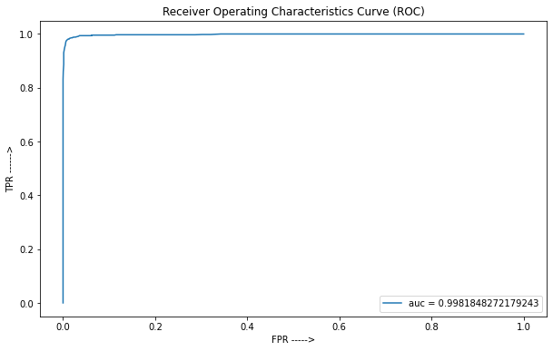
AUC & METRICS
S.No. | model_name | metrics | Is_Revenue (False) | Is_Revenue (True)
0 | Random Forest(entropy) | precision | 1.00 | 0.94
1 | Support Vector Machine | precision | 0.85 | 0.88
2 | Voting Classifier | precision | 1.00 | 0.93
3 | Logistic Regression | precision | 0.78 | 0.86
4 | Decision Tree | precision | 1.00 | 0.92
5 | Random Forest(entropy) | recall | 0.94 | 1.00
6 | Support Vector Machine | recall | 0.88 | 0.84
7 | Voting Classifier | recall | 0.92 | 1.00
8 | Logistic Regression | recall | 0.87 | 0.76
9 | Decision Tree | recall | 0.91 | 1.00
10 | Random Forest(entropy) | f1_score | 0.97 | 0.97
11 | Support Vector Machine | f1_score | 0.87 | 0.86
12 | Voting Classifier | f1_score | 0.96 | 0.96
13 | Logistic Regression | f1_score | 0.82 | 0.80
14 | Decision Tree | f1_score | 0.95 | 0.95
NOTE:
Random Forest model has delivered accurate predictions both in False as well True scenarios with 97% f1_score. Hence it is recommended to use this model.

Slide 13
DATASET OBSERVATIONS
Out of total 12330 transactions 6562 visited Admin page, out of these 6537 i.e., 99% visited product page, 2168 visited information pages. Out of 1908 Revenue generated transactions 1394 Transactions occurred from these pages. Which is 21%.
Out of total 12330 transactions 2631 visited Info page, out of these 2623 i.e., 99% visited product page, 2168 came to info from Admn pages. Revenue generated transactions is 23% from information pages
5299 transactions directly visited Product page. But Revenue generated transactions are only 427 from these 5299 transactions which is just 8%.
Overall out of 12330, 12292 visited Product pages which is 99%.
Feature importance table appended below with Top 10 features, as per which Page values feature is at top with 38% followed by producted related duration and Exit rates.
S.No. | Feature Name | importance
1 | PageValues | 0.381310
2 | ProductRelated_Duration | 0.091788
3 | ExitRates in % | 0.089217
4 | ProductRelated | 0.067117
5 | BounceRates in % | 0.057214
6 | Administrative_Duration | 0.046151
7 | Administrative | 0.039228
8 | Month_Nov | 0.029544
9 | TrafficType | 0.028132
10 | Region | 0.026786
Best feature | Name | NO. OF VISITS | % OF REVENUE GEN. VISITS
Month | November | 760 | 39.83%
Browser | 2 | 1223 | 64.10%
Visitor type | Returning_Visitor | 1470 | 77%
Traffic Type | 2 | 847 | 44.39%
Region Tye | 1 | 771 | 40.41%
Browser Type | 2 | 1223 | 64.10%
OS type | 2 | 1155 | 60.53%

Slide 14
RECOMMENDATIONS
As per Feature Importances, PageValue is the most important feature and pages with high average value contribute more to revenue generation. Replicate the characteristics of these pages in other pages to enhance page value
From EDA, and survey the month of November and May has always been great for ecommerce and revenue may be due to Festival season and Summer. We can leverage this and produce better turnouts by offering customers with holiday gifts, discounts sale, goodies etc.,
Identify the pages with high bounce rate, exit rates and divert traffic to other pages. Also enhance webpage content so that these parameters reduced.
Focus on Bests in features like returning visitor, browser-2, region-2 etc., which are generating more transactions and revenue.
Deploy the model if possible to measure time to predict behaviour in realtime

Slide 15
